Slide 1

{Dev}School DevOps Edition 2024
Bogdan Bujor
September 2024

Slide 2
Agenda
What is cloud?
Cloud types
Cloud models
Azure
Cloud vs non-cloud
Types of cloud
ING
Labs

Slide 3
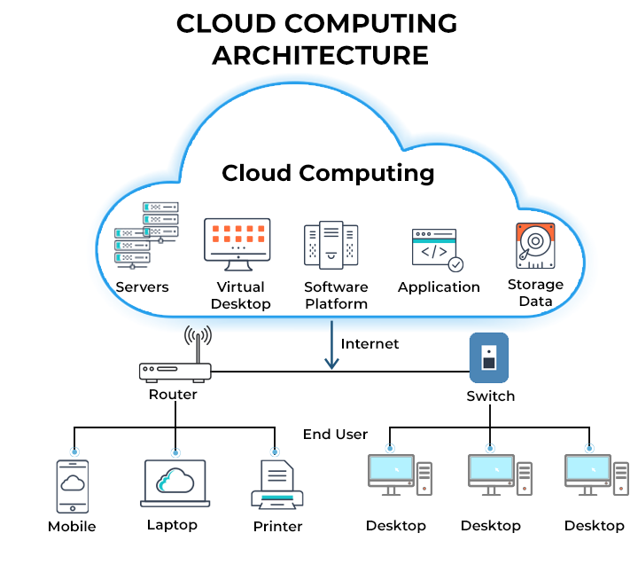
What is cloud?

Slide 4
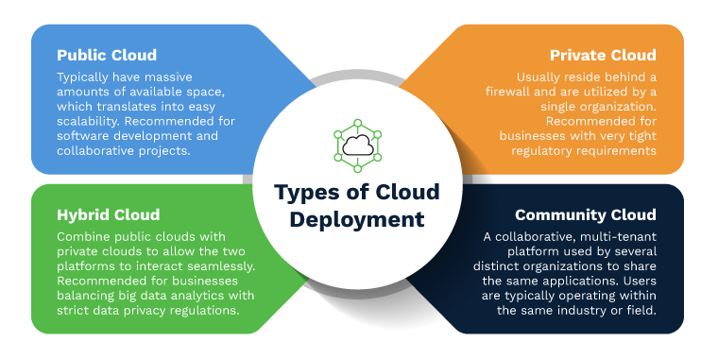
Types of cloud

Slide 5
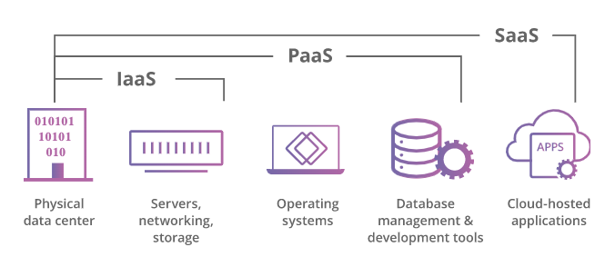
Cloud models

Slide 6
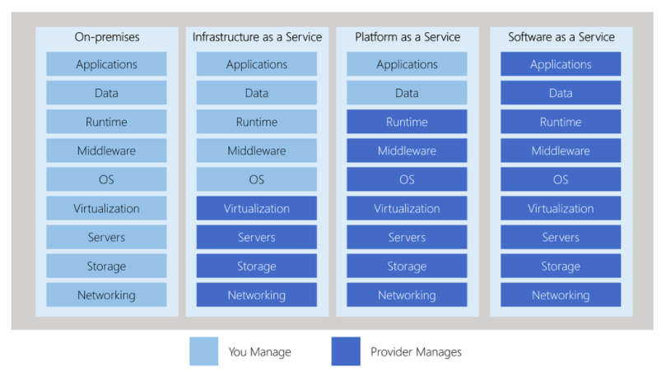
Cloud models

Slide 7
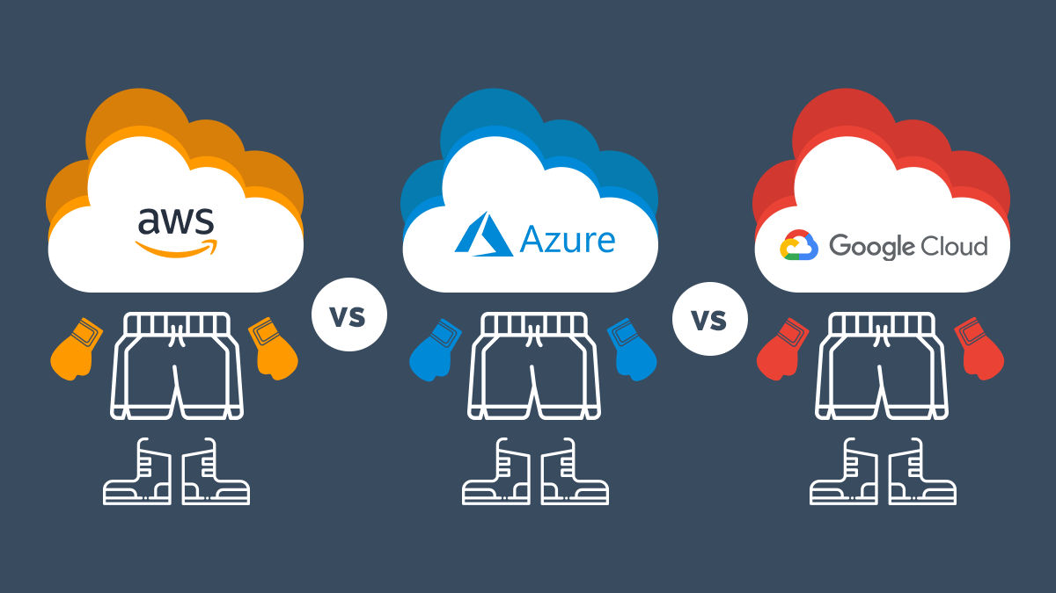

Slide 8


Slide 9
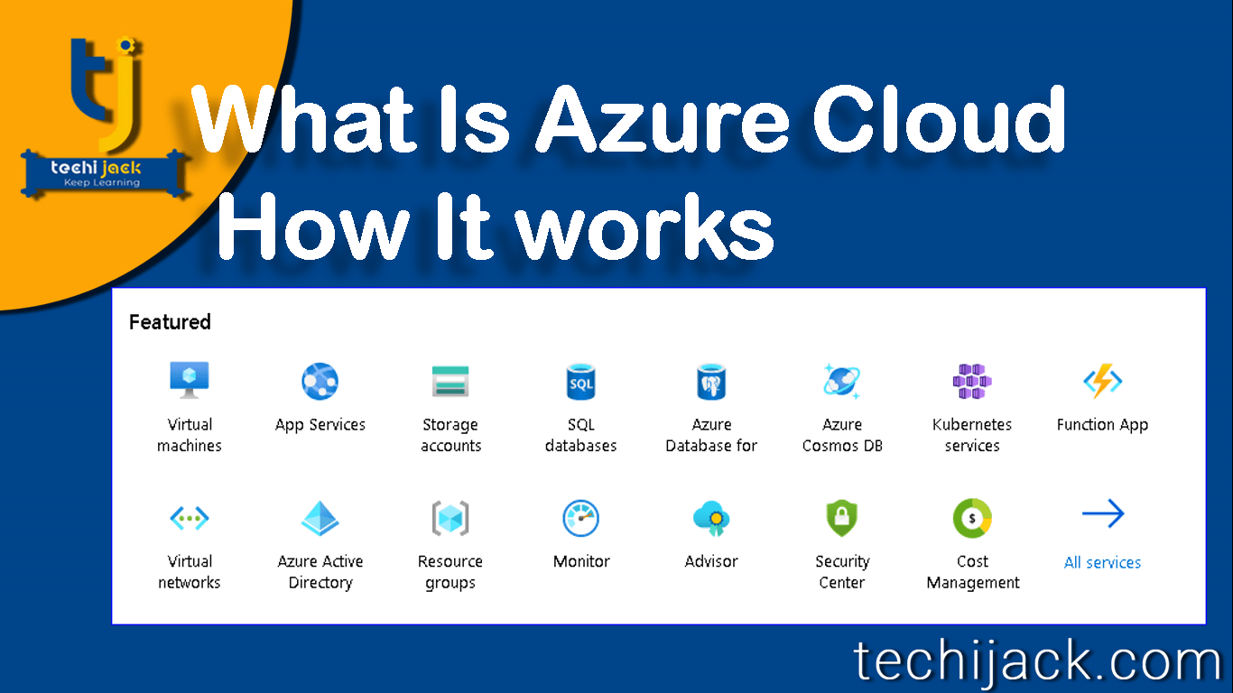

Slide 10
Azure Regions
An Azure region consists of one or more datacenters.
60+ regions worldwide
Available in 140 countries
Note: Not all services are available in all regions.
Examples
North Europe (Ireland)
West Europe (Netherlands)
Germany North
Germany West Central
East Asia (Hong Kong)
Southeast Asia (Singapore)
Australia Central
Australia Central 2

Slide 11
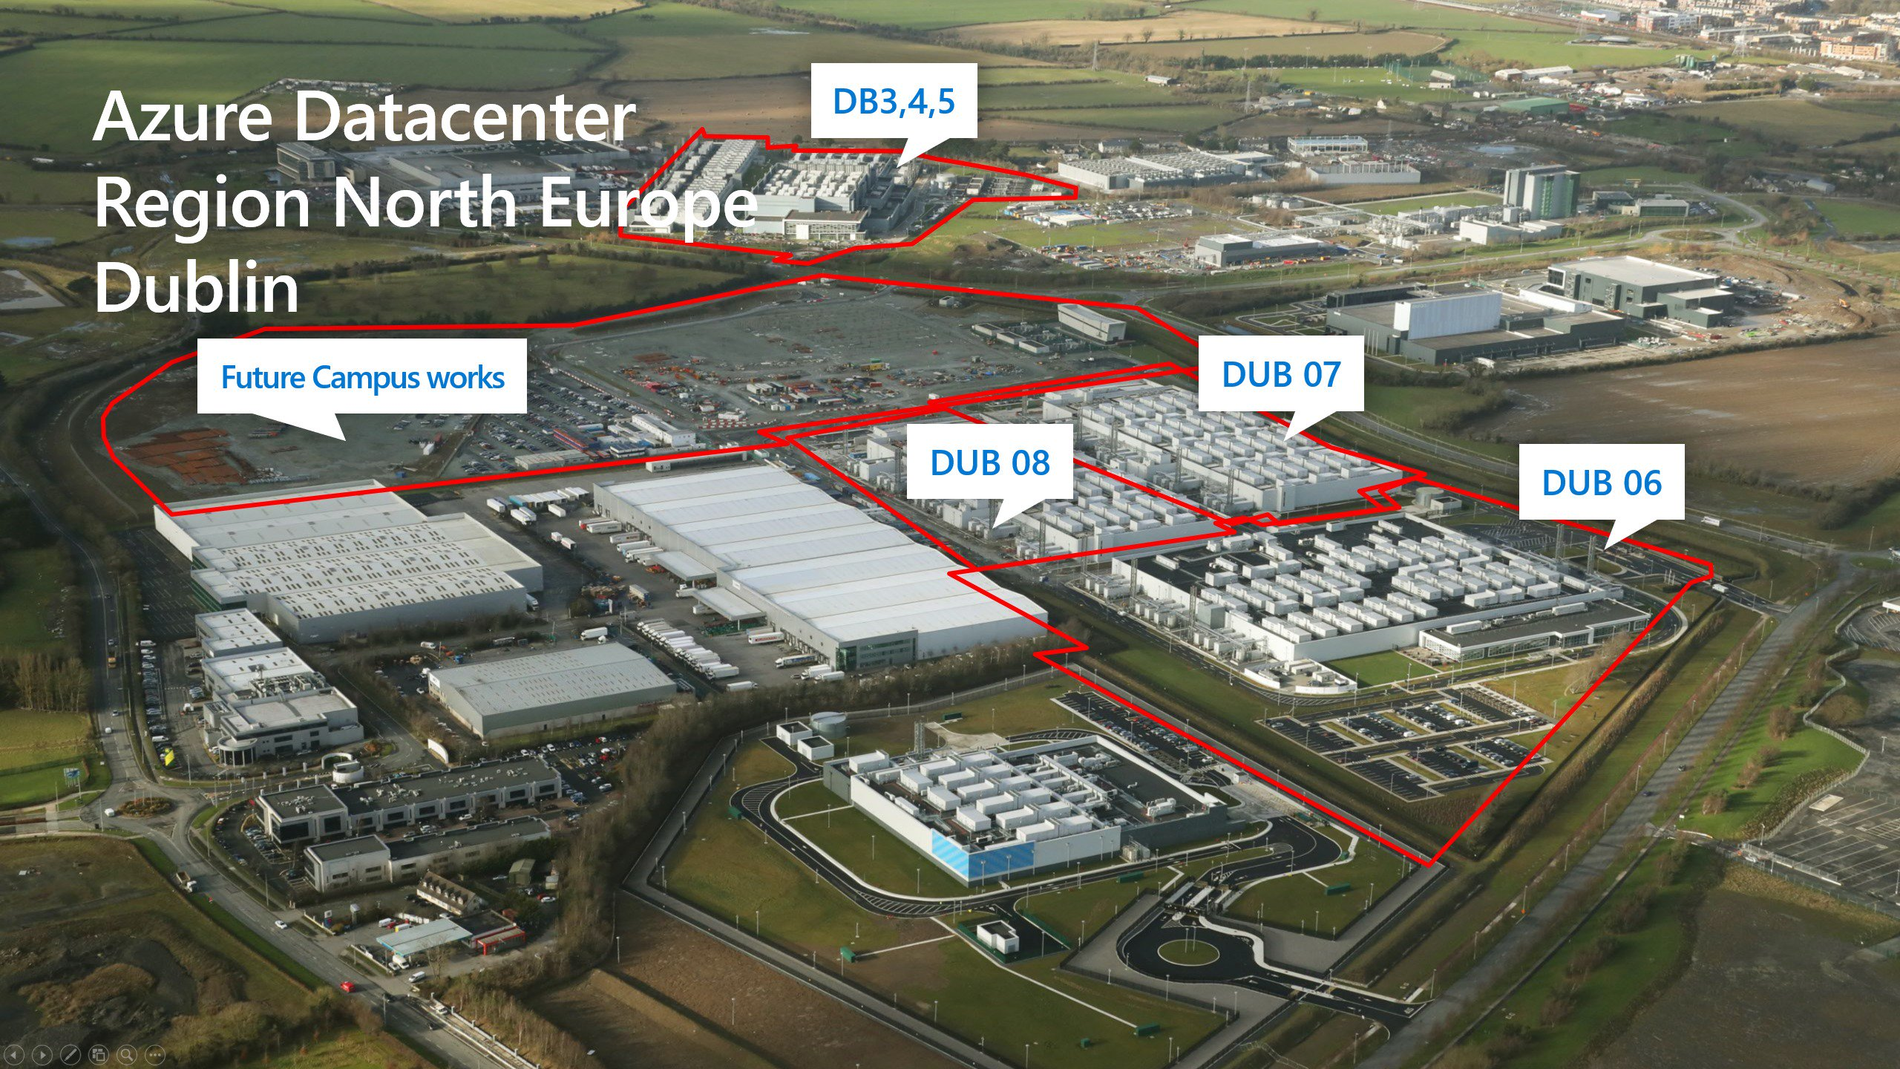

Slide 12
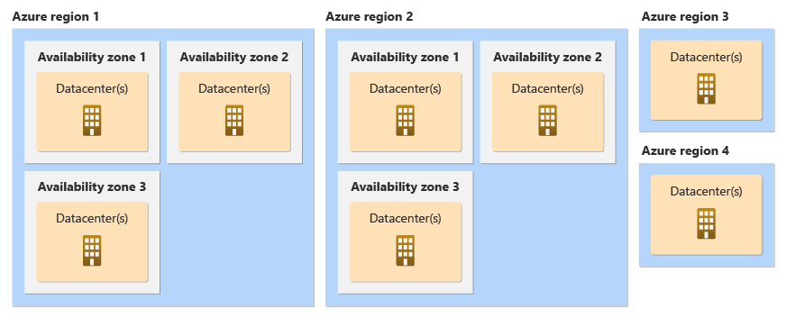
Azure Availability Zones
Availability Zones are physically separate datacenters within an Azure region:

Slide 14
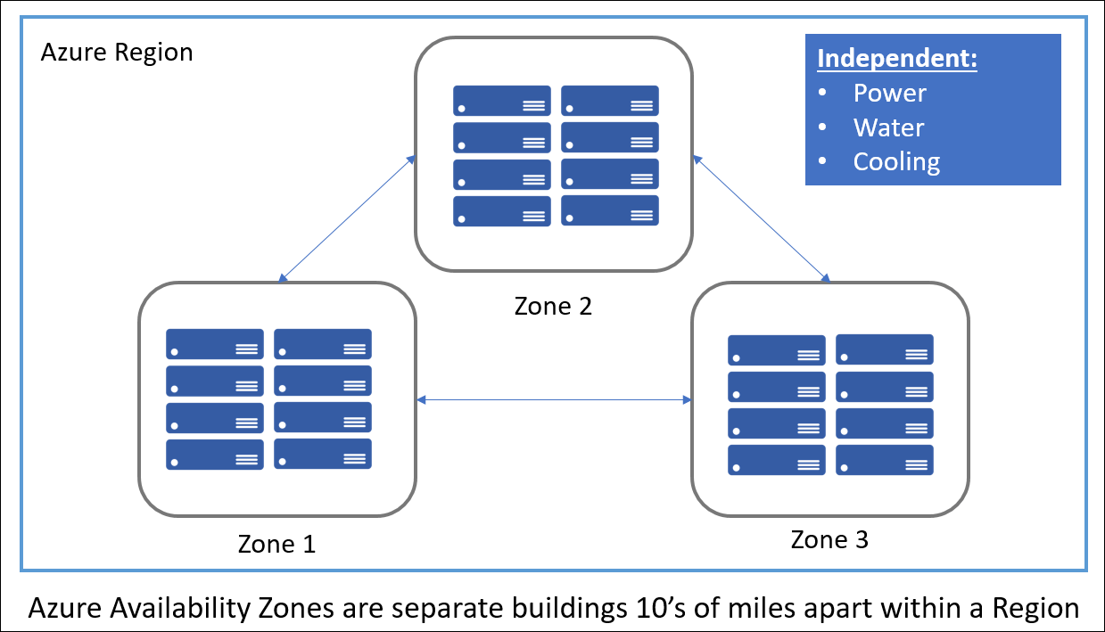
Azure Availability Zones
Availability Zones are physically separate datacenters within an Azure region:

Slide 15
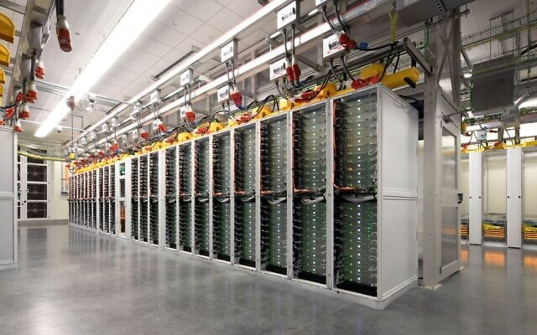

Slide 16
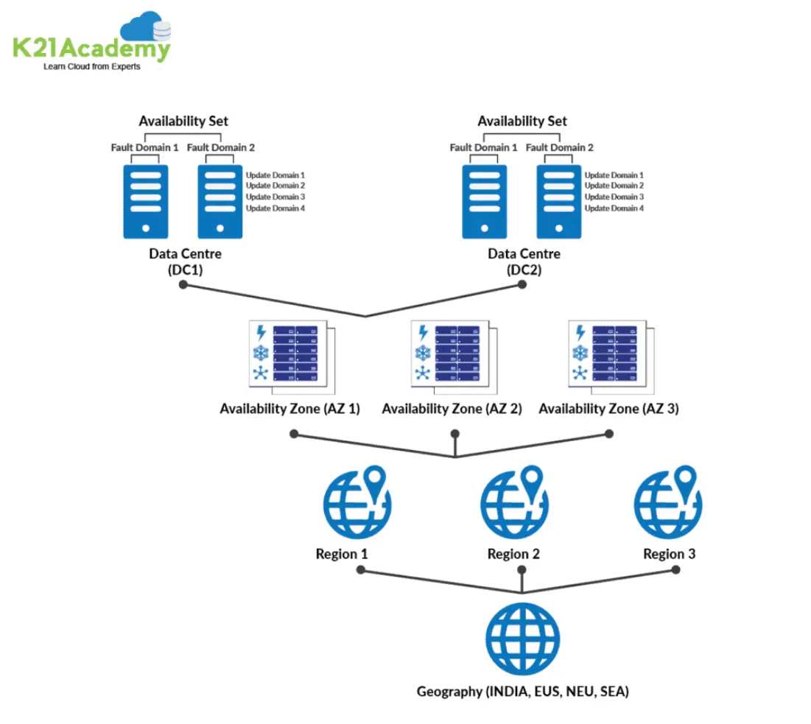

Slide 17
Cloud vs on premise (‘pe local’)

Slide 18
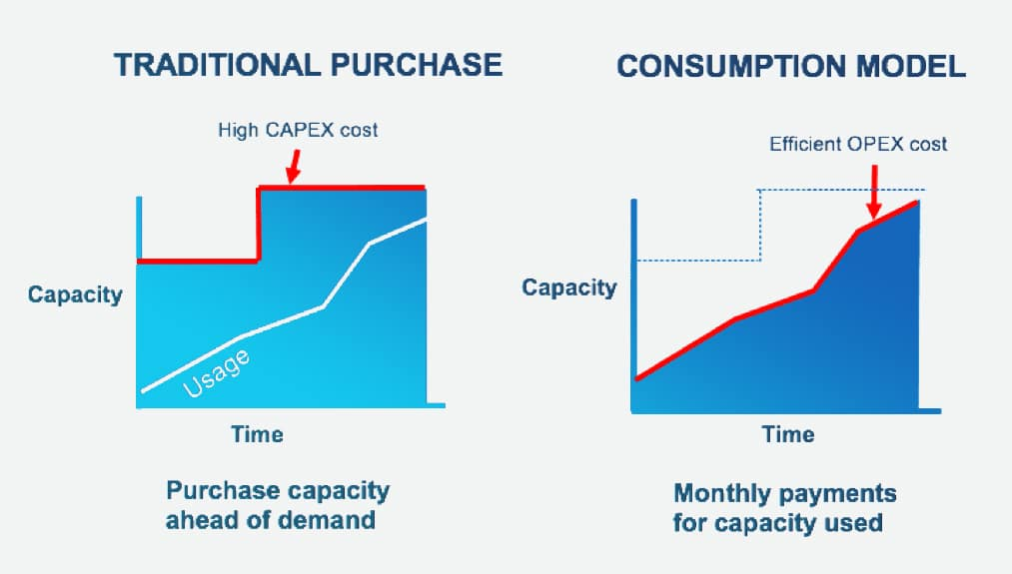
CapEx vs OpEx

Slide 19
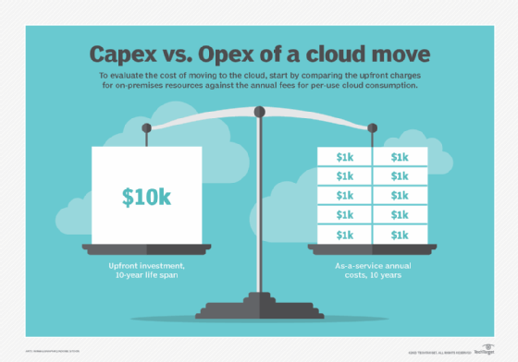

Slide 20
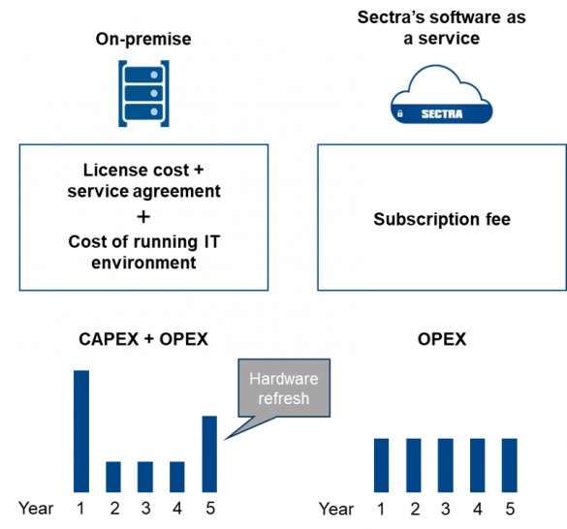

Slide 21
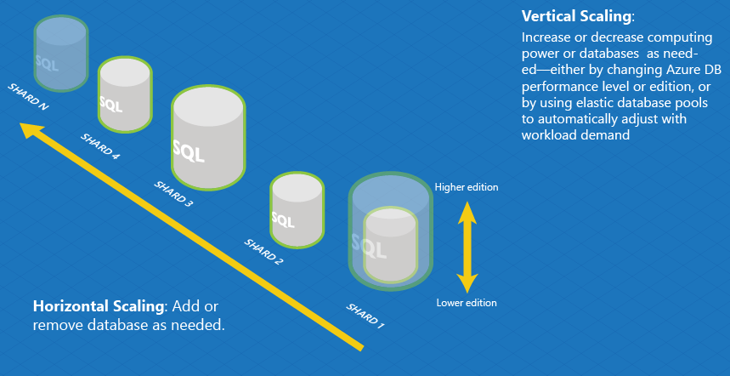

Slide 22
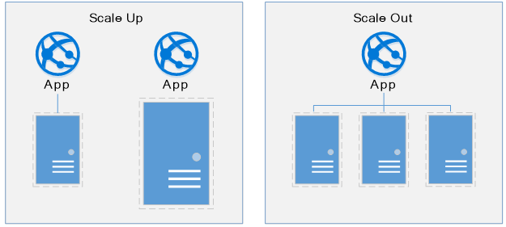

Slide 23
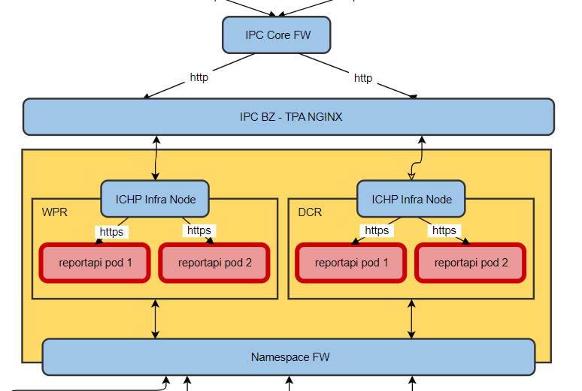
What does it look like in ING
ICHP example

Slide 24

Labs

Slide 25








Thank you!
ing.com
@ING_News
LinkedIn.com/company/ING
SlideShare.net/ING
Medium.com/ing-blog
ingwb.com
Facebook.com/ING
YouTube.com/ING
Flickr.com/INGGroup

